Slide 1
Chapter 3: Transport Layer

Slide 2
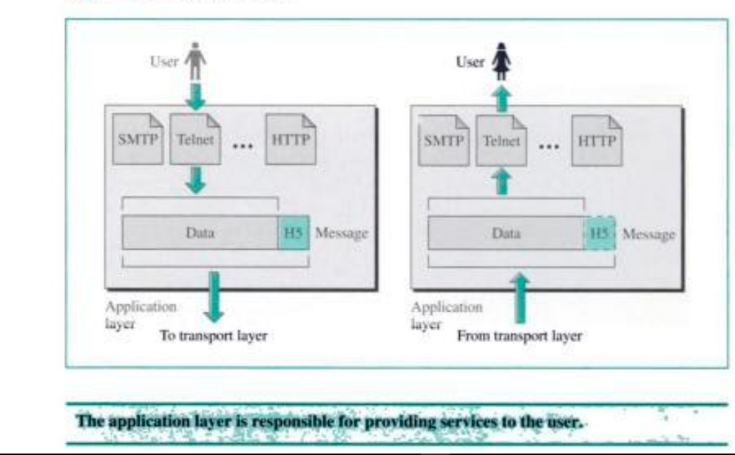
Recall
Application layer
Enables the user, whether human or software to access the network.

Slide 3
Outline
Introduction
Discussions on TL principles and discussions of how these principles are implemented in existing protocols
Multiplexing and demultiplexing
Transport layer protocols

Slide 4
Introduction
Transport layer(TL)
Critical function of TL is extending the network layer’s delivery service between two end systems to a delivery service between two application-layer processes running on the end systems.
Connection:
A transport-layer protocol provides for logical communication between application processes running on different hosts.
By logical communication, it means that from an application’s perspective, it is as if the hosts running the processes were directly connected; in reality, the hosts may be on opposite sides of the planet, connected via numerous routers and a wide range of link types.
Application processes use the logical communication provided by the transport layer to send messages to each other, free from the worry of the details of the physical infrastructure used to carry these messages.

Slide 5
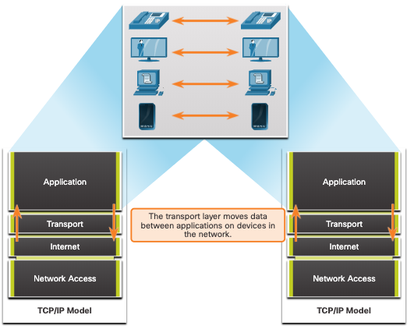
Transportation of Data Role of the Transport Layer
The transport layer is:
responsible for logical communications between applications running on different hosts.
The link between the application layer and the lower layers that are responsible for network transmission.

Slide 6
Major role of TL(Cont’d…)
TL
Responsible for process-to-process delivery of the entire message.
Ensuring that all the packets of a message sent by a source node arrive at the intended destination.
Network layer
Oversees host-to-destination delivery of individual packets
Network layer treats each packet independently
It doesn’t recognize any relationship b/n those packets
Application to application communication: The transport layer enables communication between two applications running on different computers.
Segmentation and reassembly: The transport layer breaks a message into packets, numbers them by adding sequence numbers at the destination to reassemble the original message.

Slide 7
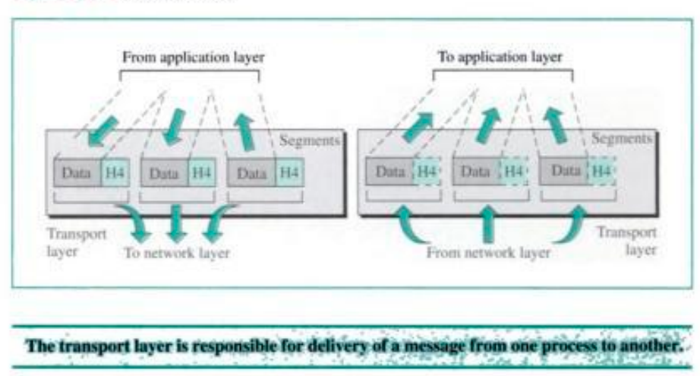
Transport layer(Cont’d…)
On sending side, the transport layer converts the application-layer messages it receives from a sending application process into transport-layer packets, known as transport-layer segments in Internet terminology.
On the receiving side, the network layer extracts the transport-layer segment from the datagram and passes the segment up to the transport layer.

Slide 8
Transport layer(cont’d..)
The transport layer then processes the received segment, making the data in the segment available to the receiving application.
More than one transport-layer protocol may be available to network applications.
For example, the Internet has two protocols—TCP and UDP.
Each of these protocols provides a different set of transport layer services to the invoking application.

Slide 9
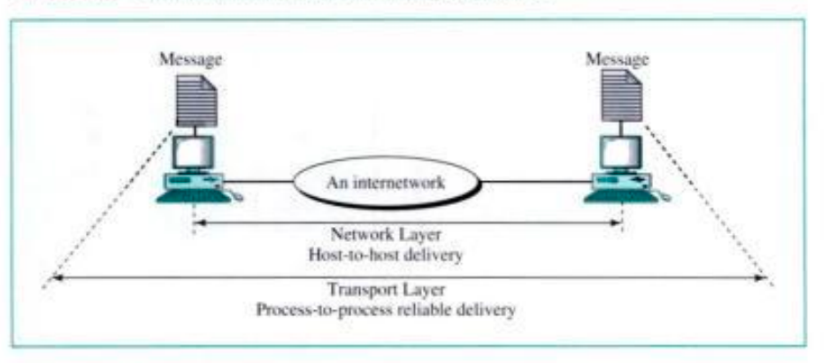
Reliable process-to-process delivery(cont’d..)
Error control
responsible for error control
it ensure the entire message arrives at receiving side without error
Port address
It must includes a type address called port address
Gets the entire message to correct process on that computer

Slide 10
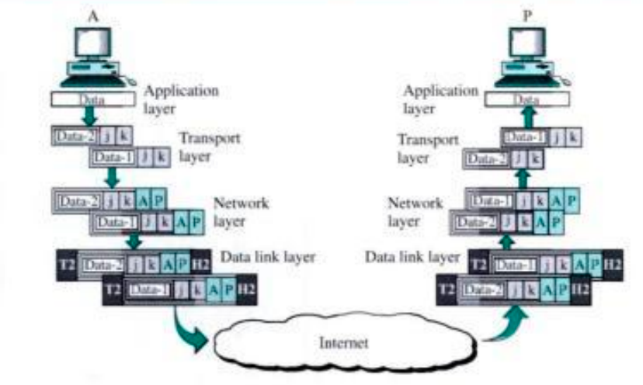
Example of TL communication(cont’d..)
Since the data size is larger than the network layer can handle; the data is split into two packets, each packets retaining the port addresses.
-Then in NL added a network address to each packets

Slide 11
Multiplexing and Demultiplexing
In this section, we discuss transport-layer multiplexing and demultiplexing, that is, extending the host-to-host delivery service provided by the network layer to a process-to-process delivery service for applications running on the hosts.
• At the destination host, the transport layer receives segments from the network layer below it.
• The transport layer has the responsibility of delivering the data in these segments to the appropriate application process running in the host.

Slide 12
Multiplexing and Demultiplexing(cont’d..)
Let’s take a look at an example.
Suppose you are sitting in front of your computer, and you are downloading Web pages while running one FTP session and two Telnet sessions.
You therefore have four network application processes running—two Telnet processes, one FTP process, and one HTTP process.
When the transport layer in your computer receives data from the network layer below, it needs to direct the received data to one of these four processes.
Let’s now examine how this is done.
First recall that a process (as part of a network application) can have one or more sockets, doors through which data passes from the network to the process and through which data passes from the process to the network.

Slide 13
Multiplexing and Demultiplexing(cont’d..)
Thus, as shown in Fig. 1, the transport layer in the receiving host does not actually deliver data directly to a process, but instead to an intermediary socket.
The combination of the source IP address and source port number, or the destination IP address and destination port number is known as a socket.
Because at any given time there can be more than one socket in the receiving host, each socket has a unique identifier.
The format of the identifier depends on whether the socket is a UDP or a TCP socket.
Now let’s consider how a receiving host directs an incoming transport layer segment to the appropriate socket.
Each transport-layer segment has a set of fields in the segment for this purpose.

Slide 14
Multiplexing and Demultiplexing(cont’d..)
At the receiving end, the transport layer examines these fields to identify the receiving socket and then directs the segment to that socket.
This job of delivering the data in a transport-layer segment to the correct socket is called demultiplexing.
The job of gathering data chunks at the source host from different sockets, encapsulating each data chunk with header information (that will later be used in demultiplexing) to create segments, and passing the segments to the network layer is called multiplexing.

Slide 15
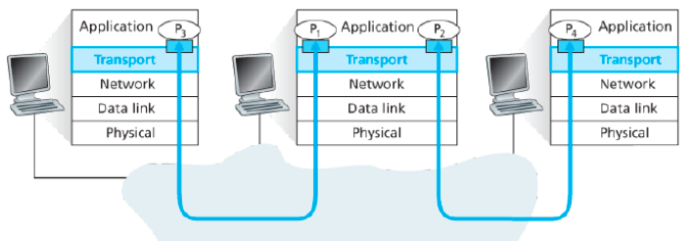

Multiplexing and Demultiplexing(cont’d..)
Note that the transport layer in the middle host in Fig. 1 must demultiplex segments arriving from the network layer below to either process P or P above; this is done by directing the arriving segment’s data to the corresponding process’s socket.
The transport layer in the middle host must also gather outgoing data from these sockets, form transport layer segments, and pass these segments down to the network layer.
The source port number serves as part of a “return address”.
32 bit
Source port # | Dest. Source port #
Other header fields
Application data(messages)
Fig. 1: Transport layer multiplexing and demultiplexing

Slide 16
Reading assignments
how a transport-layer multiplexing and demultiplexing is actually done in a host?
Connectionless Multiplexing and Demultiplexing
….

Slide 17
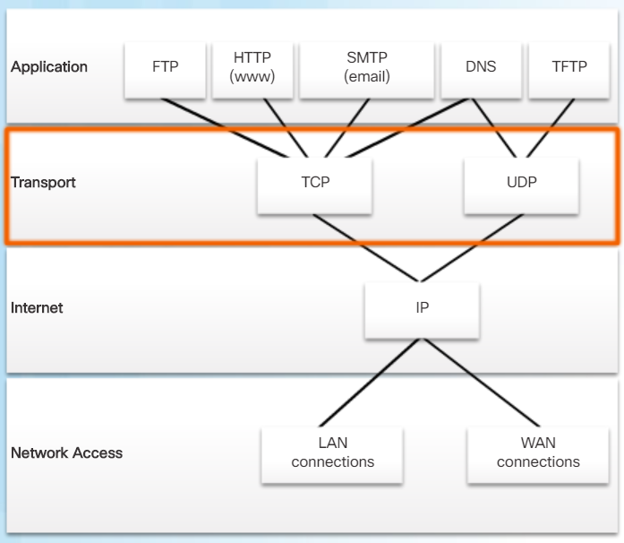
Transportation of Data Transport Layer Protocols
IP does not specify how the delivery or transportation of the packets takes place.
Transport layer protocols specify how to transfer messages between hosts, and are responsible for managing reliability requirements of a conversation.
The transport layer includes the TCP and UDP protocols.

Slide 18
Transportation of Data Transport Layer Protocols(cont’d..)
The Internet’s network-layer protocol has a name—IP, for Internet Protocol.
IP provides logical communication between hosts.
The IP service model is a best-effort delivery service.
This means that IP makes its “best effort” to deliver segments between communicating hosts, but it makes no guarantees.
In particular, it does not guarantee
•segment delivery,
orderly delivery of segments, and
the integrity of the data in the segments.
For these reasons, IP is said to be an unreliable service.

Slide 19
Transportation of Data Transport Layer Protocols(cont’d..)
The most fundamental responsibility of UDP and TCP is to extend IP’s delivery service between two end systems to a delivery service between two processes running on the end systems.
Extending host-to-host delivery to process-to-process delivery is called transport-layer multiplexing and demultiplexing.
UDP and TCP also provide integrity checking by including error
These two minimal transport-layer services
– process-to-process data delivery and
– error checking

Slide 20
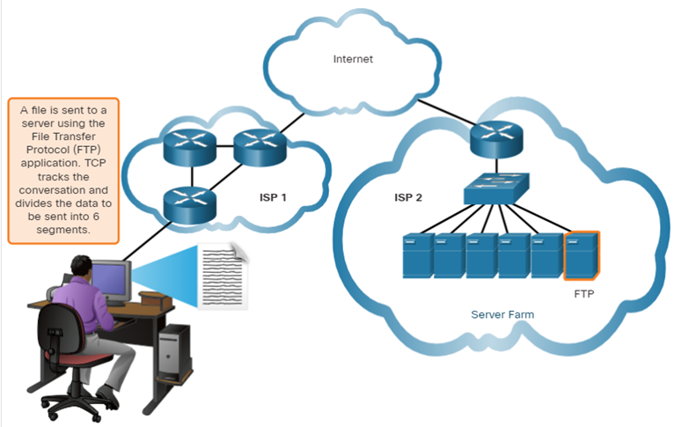
Transportation of Data Transmission Control Protocol
TCP provides reliability and flow control. TCP basic operations:
Number and track data segments transmitted to a specific host from a specific application
Acknowledge received data
Retransmit any unacknowledged data after a certain amount of time
Sequence data that might arrive in wrong order
Send data at an efficient rate that is acceptable by the receiver

Slide 21
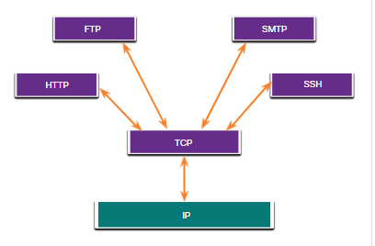
TCP Overview TCP(cont’d..)
TCP Overview Applications that use TCP
TCP handles all tasks associated with dividing the data stream into segments, providing reliability, controlling data flow, and reordering segments.
TCP also provides congestion control.
Congestion control prevents any one TCP connection from swamping the links and routers between communicating hosts with an excessive amount of traffic.
TCP strives to give each connection traversing a congested link an equal share of the link bandwidth.

Slide 22
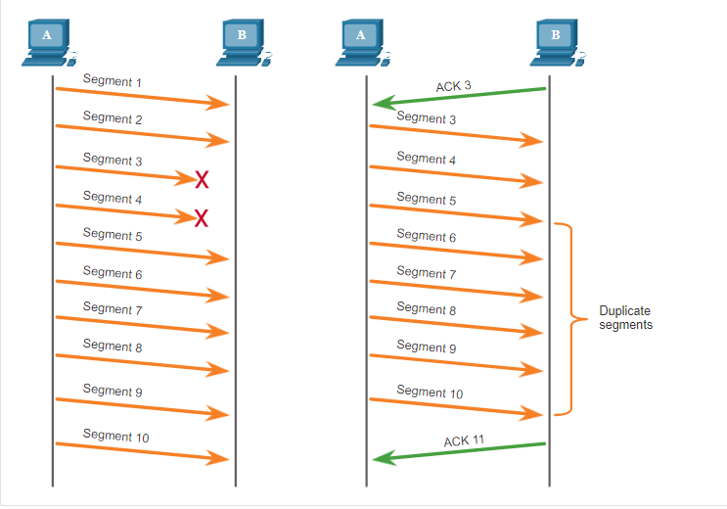
Reliability and Flow Control TCP Reliability – Data Loss and Retransmission
No matter how well designed a network is, data loss occasionally occurs.
TCP provides methods of managing these segment losses. Among these is a mechanism to retransmit segments for unacknowledged data.

Slide 23
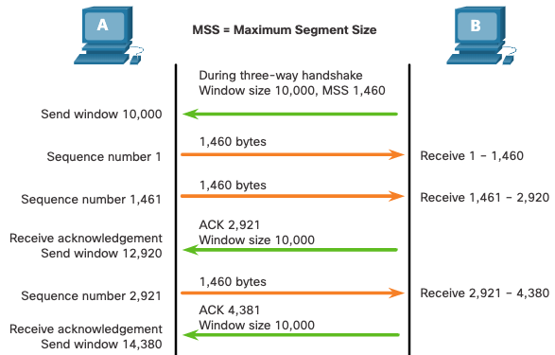
Reliability and Flow Control TCP Flow Control – Window Size and Acknowledgments
TCP also provides mechanisms for flow control as follows:
Flow control is the amount of data that the destination can receive and process reliably.
Flow control helps maintain the reliability of TCP transmission by adjusting the rate of data flow between source and destination for a given session.
Window size- the size of the receiver buffer

Slide 24
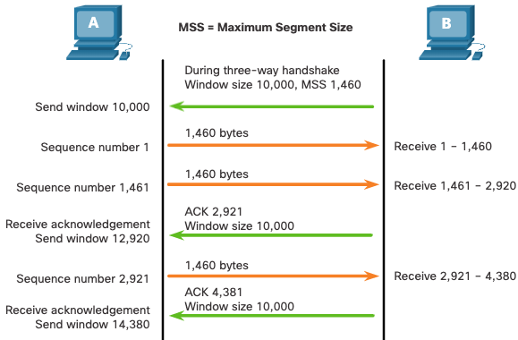
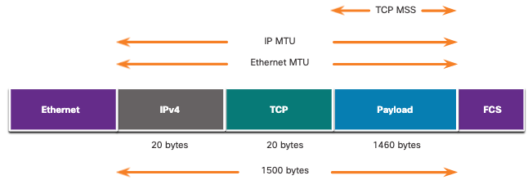
Maximum Segment Size (MSS) is the maximum amount of data that the destination device can receive.
A common MSS is 1,460 bytes when using IPv4.
A host determines the value of its MSS field by subtracting the IP and TCP headers from the Ethernet maximum transmission unit (MTU), which is 1500 bytes be default.
1500 minus 40 (20 bytes for the IPv4 header and 20 bytes for the TCP header) leaves 1460 bytes.

Slide 25
UDP Overview UDP protocol
In particular, like IP, UDP is an unreliable service—it does not guarantee that data sent by one process will arrive intact (or at all!) to the destination process.
UDP features include the following:
Data is reconstructed in the order that it is received.
Any segments that are lost are not resent.
There is no session establishment.
The sending is not informed about resource availability.

Slide 26
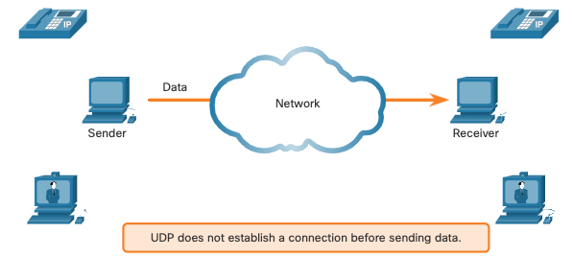
UDP Communication UDP Low Overhead versus Reliability
UDP does not establish a connection. UDP provides low overhead data transport because it has a small datagram header and no network management traffic.

Slide 27
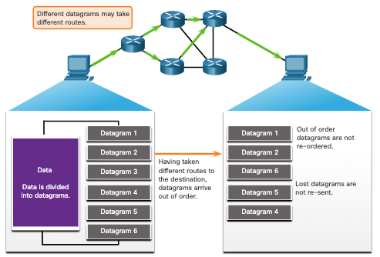
UDP Communication UDP Datagram Reassembly
UDP does not track sequence numbers the way TCP does.
UDP has no way to reorder the datagrams into their transmission order.
UDP simply reassembles the data in the order that it was received and forwards it to the application.

Slide 28
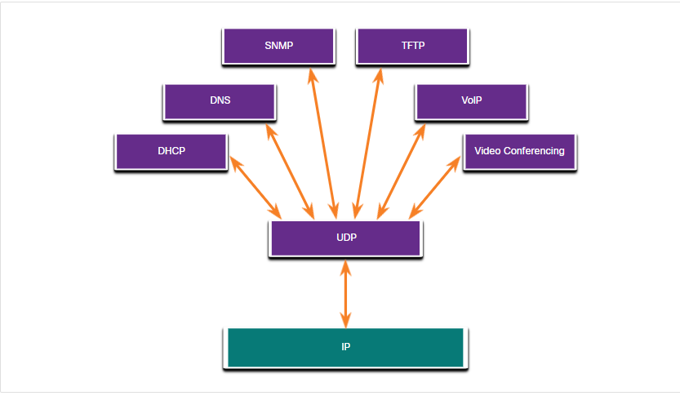
UDP Overview Applications that use UDP
Live video and multimedia applications - These applications can tolerate some data loss but require little or no delay. Examples include VoIP and live streaming video.
Simple request and reply applications - Applications with simple transactions where a host sends a request and may or may not receive a reply. Examples include DNS and DHCP.
Applications that handle reliability themselves - Unidirectional communications where flow control, error detection, acknowledgments, and error recovery is not required, or can be handled by the application. Examples include SNMP and TFTP.

Slide 29

Port Numbers Multiple Separate Communications
TCP and UDP transport layer protocols use port numbers to manage multiple, simultaneous conversations.
The source port number is associated with the originating application on the local host whereas the destination port number is associated with the destination application on the remote host.

Slide 30
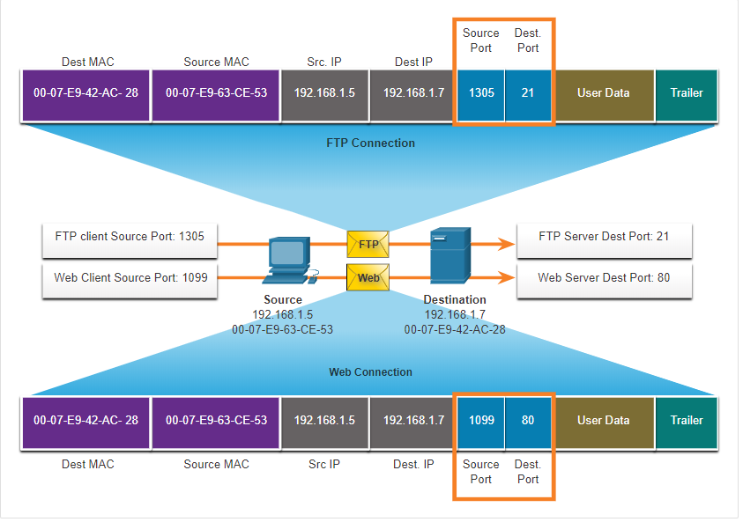
Port numbers Socket Pairs
The source and destination ports are placed within the segment.
The segments are then encapsulated within an IP packet.
The combination of the source IP address and source port number, or the destination IP address and destination port number is known as a socket.
Sockets enable multiple processes, running on a client, to distinguish themselves from each other, and multiple connections to a server process to be distinguished from each other.

Slide 31
Port Numbers Port Number Groups
Port Group | Number Range | Description
Well-known Ports | 0 to 1,023 | These port numbers are reserved for common or popular services and applications such as web browsers, email clients, and remote access clients. Defined well-known ports for common server applications enables clients to easily identify the associated service required.
Registered Ports | 1,024 to 49,151 | These port numbers are assigned by IANA to a requesting entity to use with specific processes or applications. These processes are primarily individual applications that a user has chosen to install, rather than common applications that would receive a well-known port number. For example, Cisco has registered port 1812 for its RADIUS server authentication process.
Private and/or Dynamic Ports | 49,152 to 65,535 | These ports are also known as ephemeral ports. The client’s OS usually assign port numbers dynamically when a connection to a service is initiated. The dynamic port is then used to identify the client application during communication.
Each port number is a 16-bit number, ranging from 0 to 65535.
The list of well-known port numbers is given in RFC 1700 and is updated at http://www.iana.org [RFC 3232].

Slide 32
Port Numbers Port Number Groups (Cont.)
Port Number | Protocol | Application
20 | TCP | File Transfer Protocol (FTP) - Data
21 | TCP | File Transfer Protocol (FTP) - Control
22 | TCP | Secure Shell (SSH)
23 | TCP | Telnet
25 | TCP | Simple Mail Transfer Protocol (SMTP)
53 | UDP, TCP | Domain Name Service (DNS)
67 | UDP | Dynamic Host Configuration Protocol (DHCP) - Server
68 | UDP | Dynamic Host Configuration Protocol - Client
69 | UDP | Trivial File Transfer Protocol (TFTP)
80 | TCP | Hypertext Transfer Protocol (HTTP)
110 | TCP | Post Office Protocol version 3 (POP3)
143 | TCP | Internet Message Access Protocol (IMAP)
161 | UDP | Simple Network Management Protocol (SNMP)
443 | TCP | Hypertext Transfer Protocol Secure (HTTPS)

Slide 33
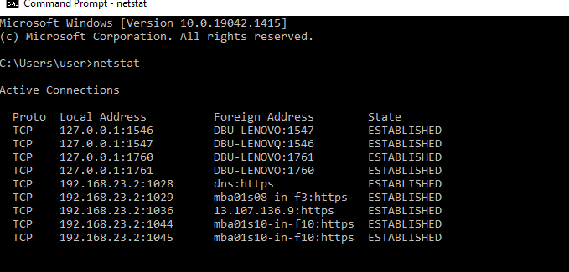
Port Numbers The netstat Command
Unexplained TCP connections can pose a major security threat. Netstat is an important tool to verify connections.

Slide 34
Summary of duties: According to Internet protocol model
Network layer
To move packets from source to destination; to provide internetworking.
Application layer
To allow access to network resources.
Transport layer
To provide reliable process-to-process message delivery and error recovery.
Physical layer
To transmit bits over a medium; to provide mechanical and electrical specifications.
Data link layer
To organize bits into frames; to provide hop-to-hop delivery.

Slide 35
End chapter three

